Slide 1
SUPER MARKET SALES DASHBOARD
Presented By:
Rawan Mohamed Ismail
Rania Emad Fawzy
Nouran Ehab Ahmed
Verina Hany Fawzy
Reham Eid Mohamed
supervised by: Eng/ Abdullah Kamal

Slide 2
Project Overview
The project aimed to develop a user-friendly, interactive dashboard to analyze key sales metrics for a supermarket. The focus was on enabling stakeholders to explore data such as sales performance, customer demographics, and product line trends. This dashboard was designed to provide insights that could guide decision-making and optimize business strategies

Slide 3
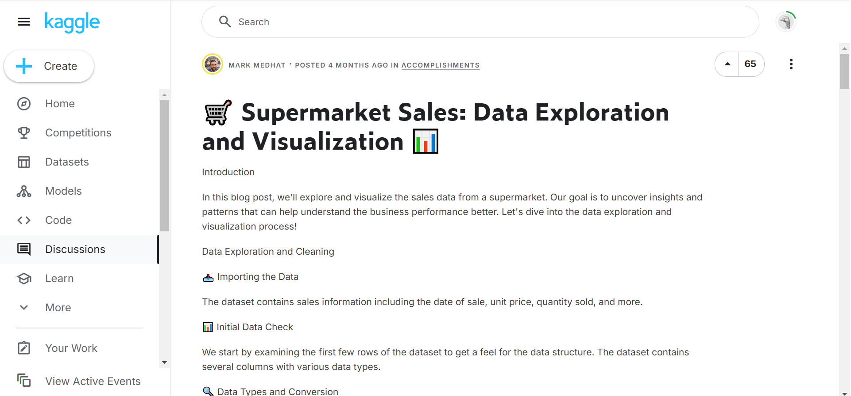
Data Collection
The data for this project was sourced from a publicly available dataset on Kaggle. It included supermarket sales data with key variables like transaction details, customer segments, and product categories. This dataset provided a rich foundation for exploring sales trends and customer behavior.

Slide 4
Data Cleaning
The raw data required a comprehensive cleaning process to ensure its accuracy and suitability for analysis. We employed several data preprocessing techniques, which included:
Handling Missing Data: We addressed missing values to maintain data completeness, using methods such as filling in gaps or excluding incomplete records when appropriate.
Standardization: Various fields and categories were standardized to ensure consistency, making the data easier to work with across the project.
Error Correction and Duplication: duplicate entries were identified and resolved to improve the overall data quality.
This data cleaning process was crucial to ensuring that our dataset was accurate, reliable, and ready for analysis.

Slide 5
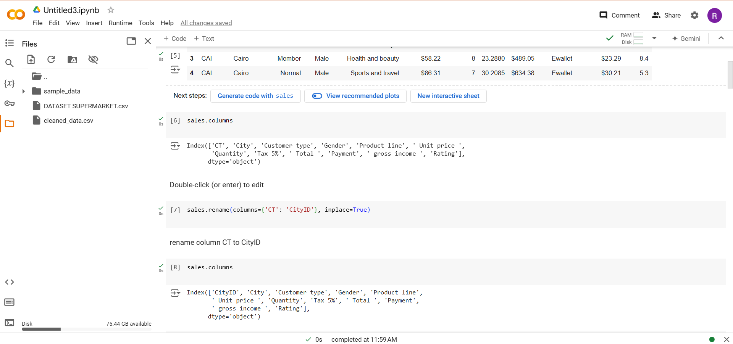
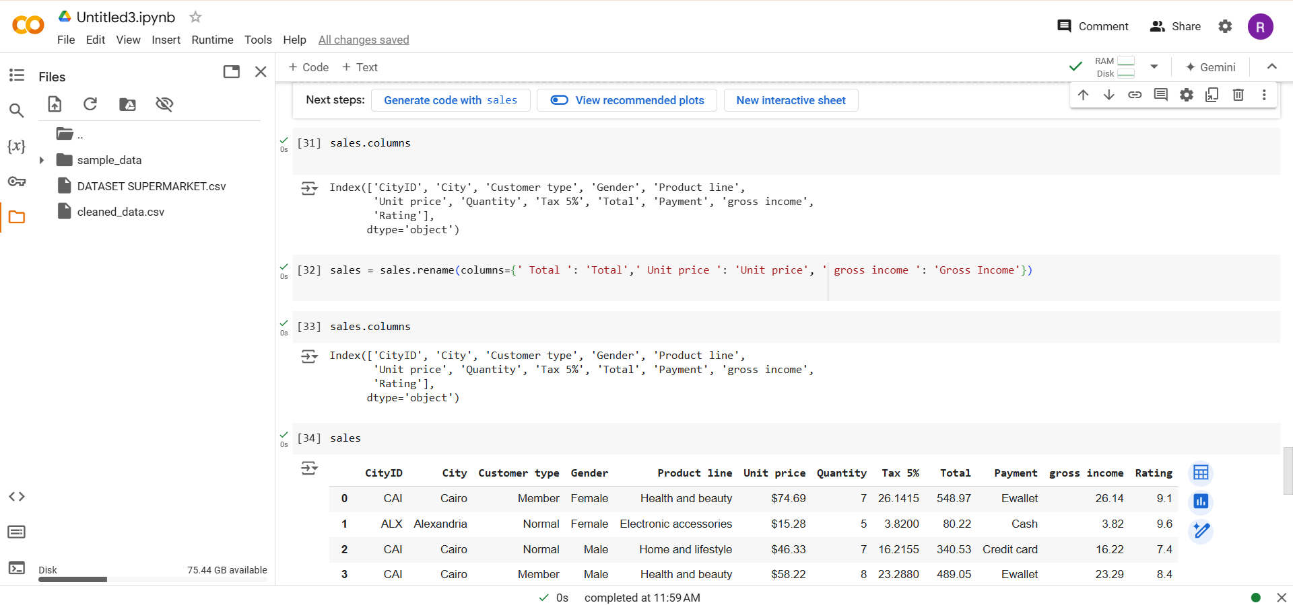
Data Cleaning Process
Data Assessment:
During the data cleaning phase, we thoroughly examined the raw data to identify any inconsistencies, missing values, or erroneous entries.
This assessment was essential to understand the data structure and to pinpoint specific areas that required cleaning before we could move forward with analysis.
Handling Missing Data:
One of the critical steps in the data cleaning process involved dealing with missing values. We utilized various techniques, such as filling in gaps using mean, median, or mode for numerical data, and forward/backward filling for time-series data.
In some cases, we decided to exclude incomplete records if they were deemed non-essential or too sparse to contribute to reliable analysis.

Slide 6
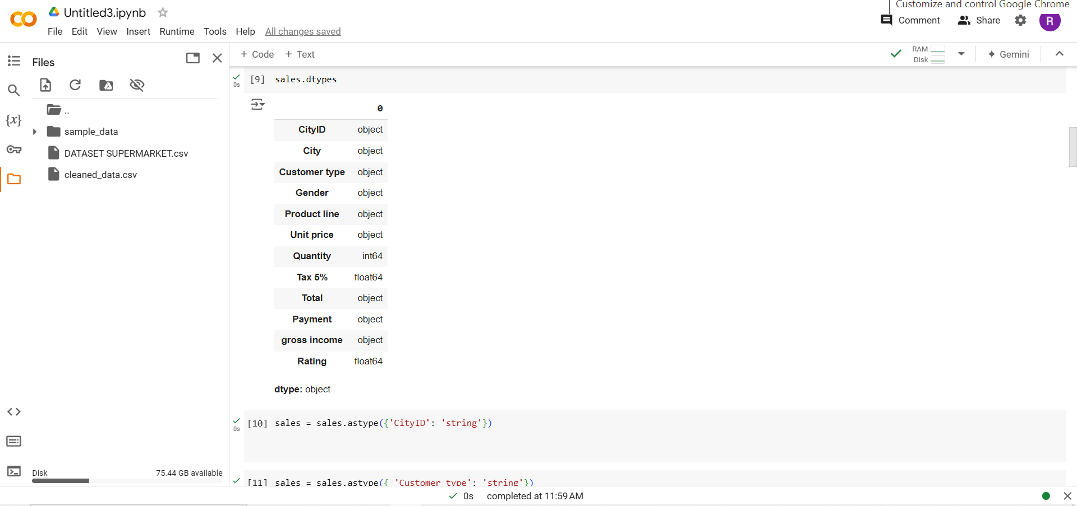
Data Cleaning Process
Standardization and Categorization:
To ensure uniformity across the dataset, we standardized various fields. This included converting data to consistent units, formats, and categories where necessary.
Standardization was crucial for reducing redundancy and enabling a smoother analysis process by ensuring that all data points were comparable.
Error Correction and Duplicates:
We addressed any errors that emerged during the data cleaning phase.
This included correcting obvious typographical errors, removing duplicate records, and validating entries to ensure their correctness.

Slide 7
Ready for Visualization
By resolving these issues, we enhanced the overall accuracy and reliability of the dataset, ensuring that it was primed for analysis.

Slide 8
Data Visualization
Once the data was cleaned, it was visualized using an interactive Tableau dashboard. The visualizations were designed to provide key insights at a glance while enabling users to:
Track Sales Trends: Identify patterns in sales performance over time.
Explore Customer Segments: Understand the purchasing behaviors of different customer types.
Analyze Product Line Performance: Highlight the best and worst-performing product categories.
Interactive features such as slicers was incorporated to enhance the user experience, making the data more accessible for in-depth exploration.

Slide 9

DATA VISUALIZATION PHASES
01
02
03
COLLECT
CLEAN
05
04
VISUALIZATION
TRANSFORMATION

Slide 10

QUESTIONS
1. What were the key objectives of the project?
01
3. What insights can stakeholders gain from the dashboard?
2. How did accuracy of you ensure the the data used in the dashboard?
03
02

Slide 11
Insights
Seasonal Sales Trends:
Customer Segmentation:
Peaks and dips in sales performance during specific time periods
1
Demonstrated the purchasing preferences of various customer groups, informing targeted marketing strategies.
2
3
Top-Performing Product Lines:
4
Customer Loyalty Trends:
Highlighted repeat purchases and customer loyalty patterns, allowing the supermarket to develop targeted retention strategies through personalized promotions and loyalty programs.
Identified the categories that contributed most to revenue.

Slide 12




Python
01
For data cleaning and preprocessing, ensuring the dataset was ready for analysis
Tableau
02
TOOLS USED
To build the interactive and visualize the data in an engdashboardaging, user-friendly manner.
03
Kaggle
As the source of the supermarket sales dataset.
04
Excel
Used for preliminary data exploration and handling.

Slide 13
Conclusion
In conclusion, our project successfully delivered an intuitive Tableau dashboard that allows stakeholders to easily explore key sales metrics, customer behavior, and product performance.
By combining effective data cleaning and visualization, it provides actionable insights to optimize operations, such as inventory management and pricing strategies.
The dashboard offers significant value in decision-making, with potential for future enhancements like real-time data integration and predictive analytics to further strengthen business strategy. Ultimately, the project highlights the power of data visualization in transforming raw data into strategic insights.

Slide 14


